Slide 1
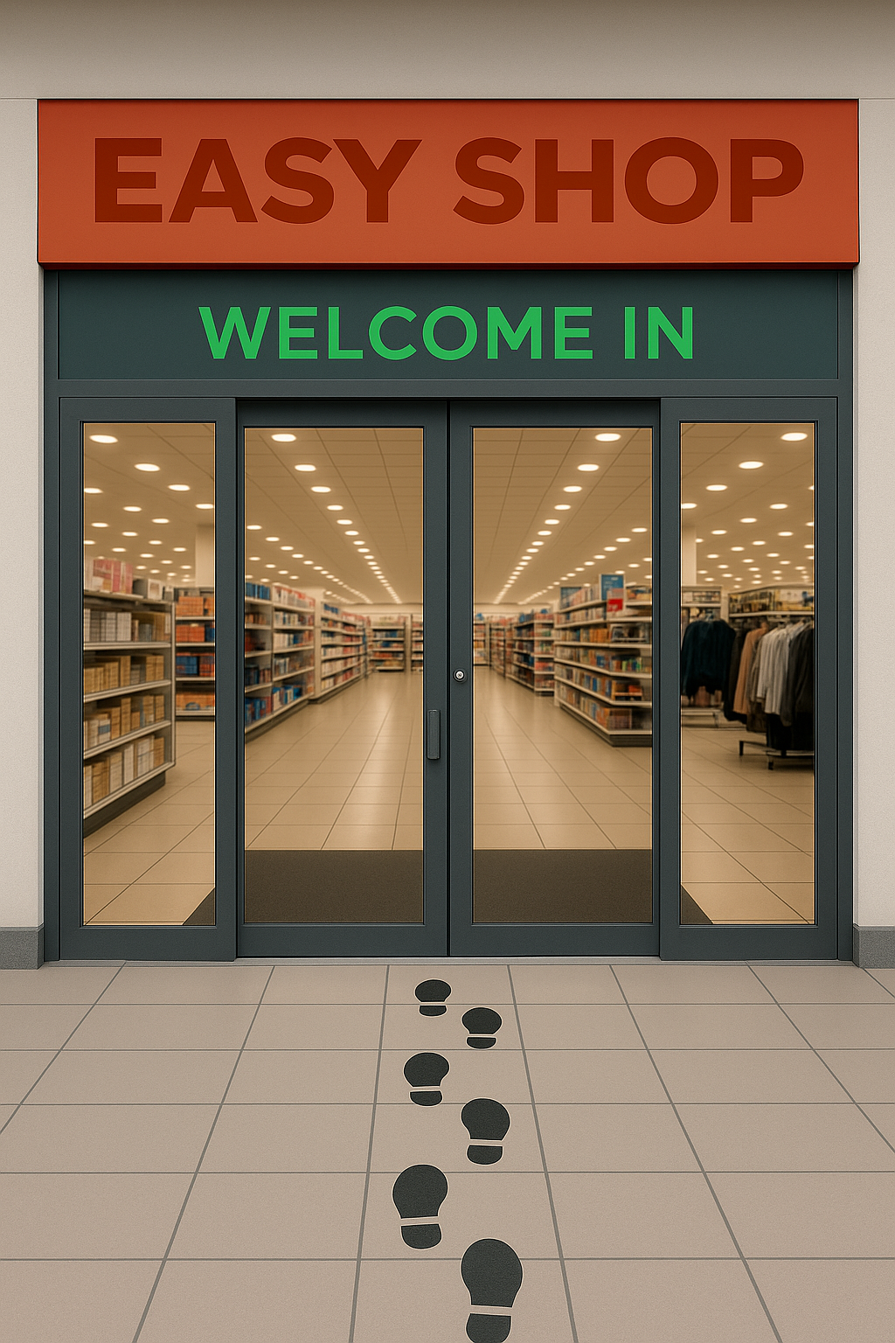

Slide 2

Aisle 1: What’s This Shop?
AUDIENCE: Online shoppers who want everything in one place
PURPOSE: Helping people shop easily & feel cared for
My Role: Thought through every step so users feel seen, not stressed.

Slide 3


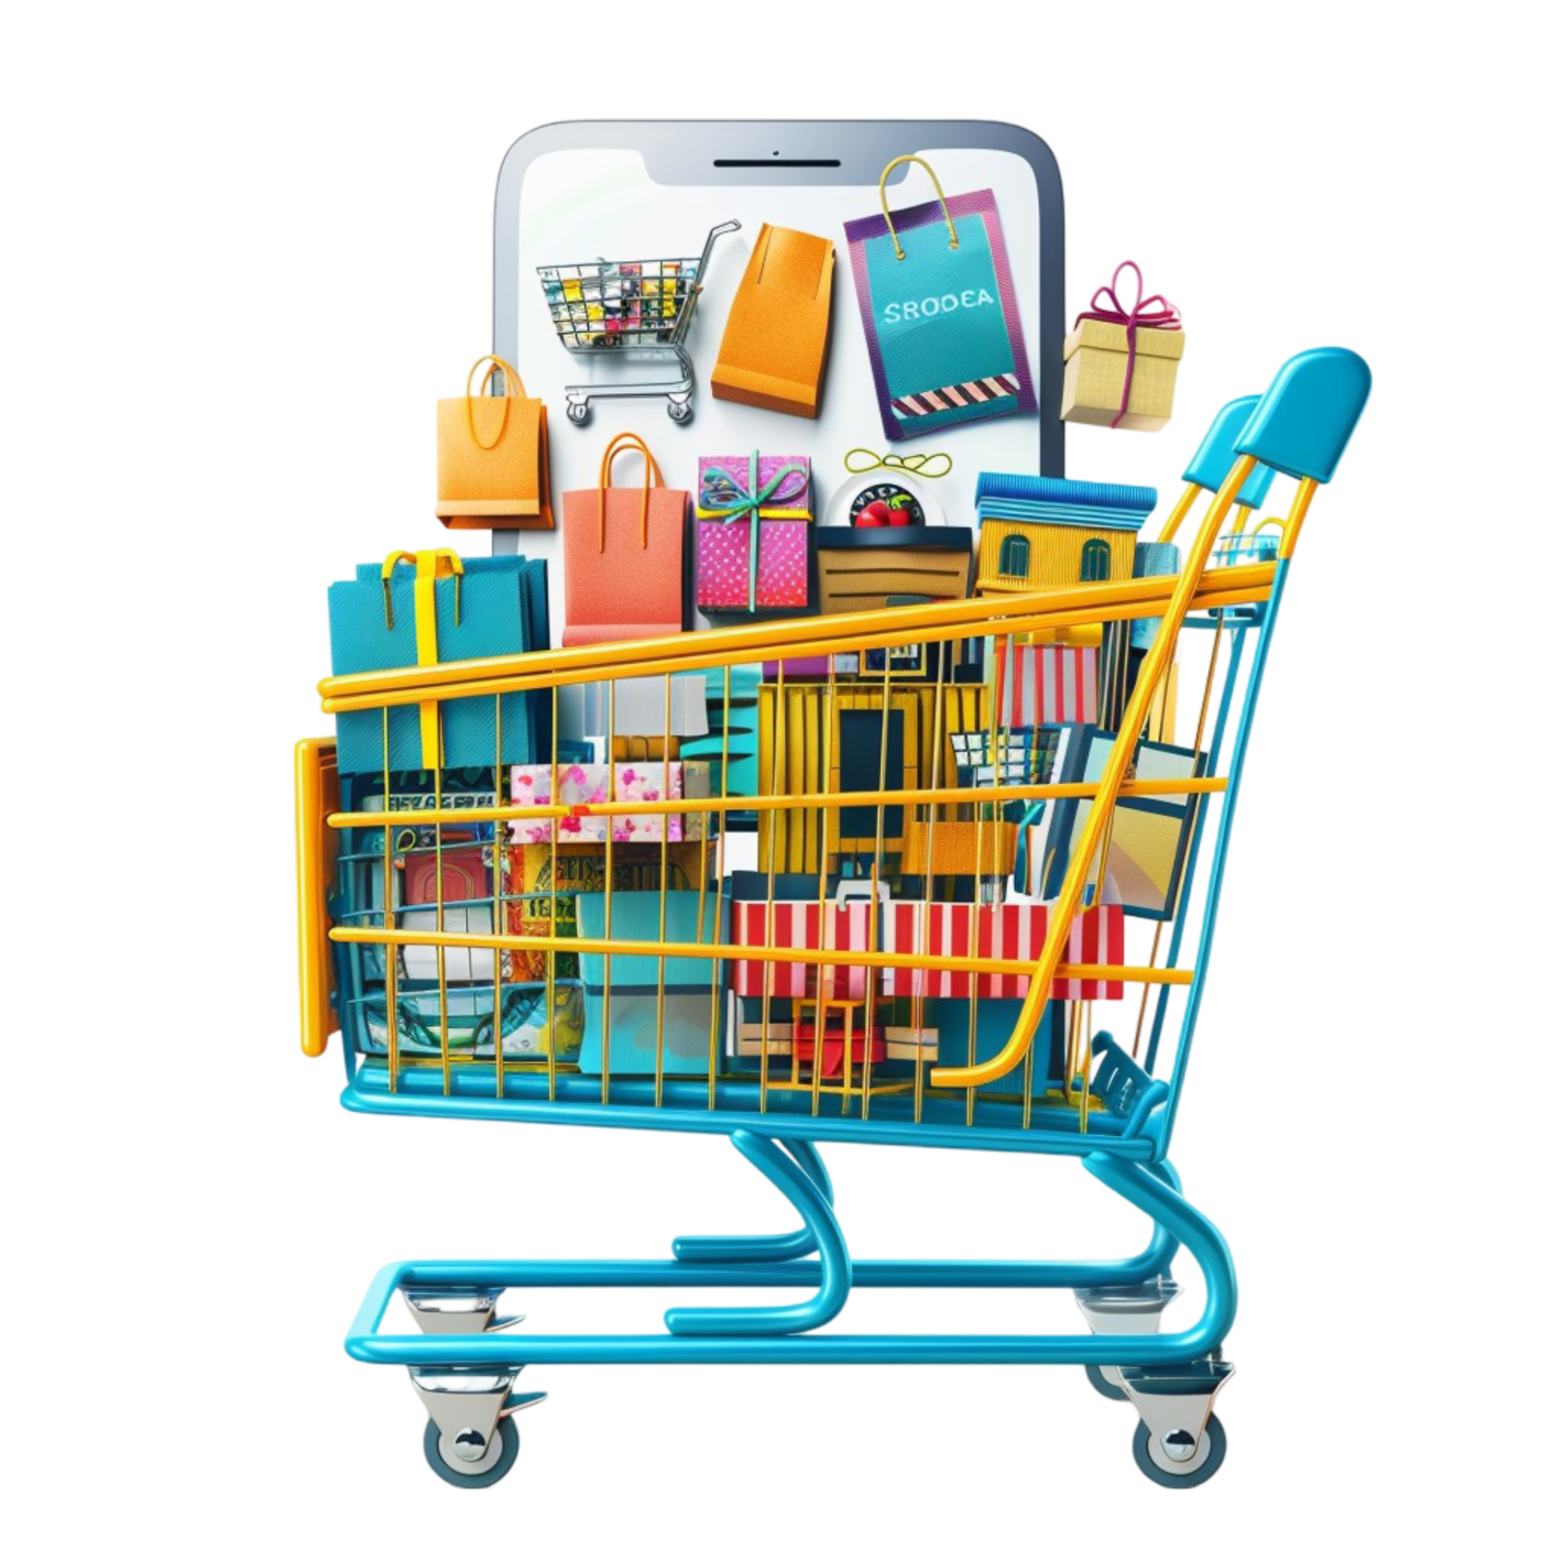
Aisle 4: User Journey
Mood Quiz
Add to Cart
or Go Home
Checkout
Login
Shop Site
Order Success

Slide 4
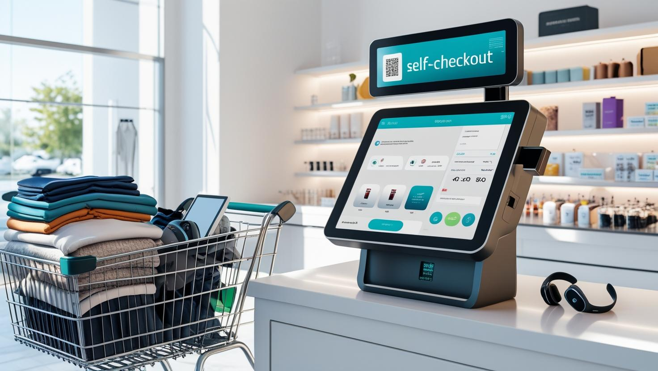
Aisle 6: Self-Checkout
User’s Final Stop: self-checkout. I’ll walk you through how a user finishes their order—from cart to confirmation.
http://localhost:63342/capstone-client-web-application/index.html?_ijt=d8b8ejjjd6ukm6uovci27ufhre&_ij_reload=RELOAD_ON_SAVE

Slide 5
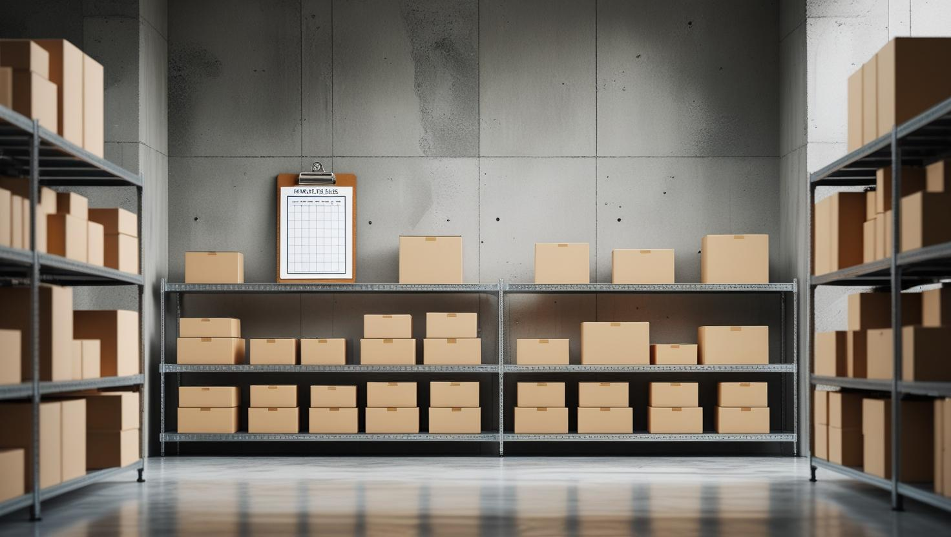
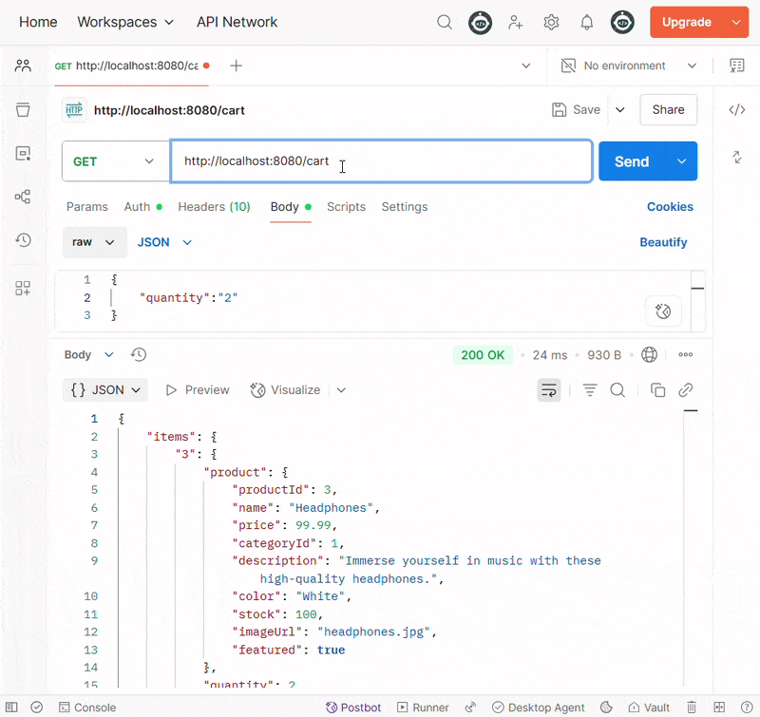
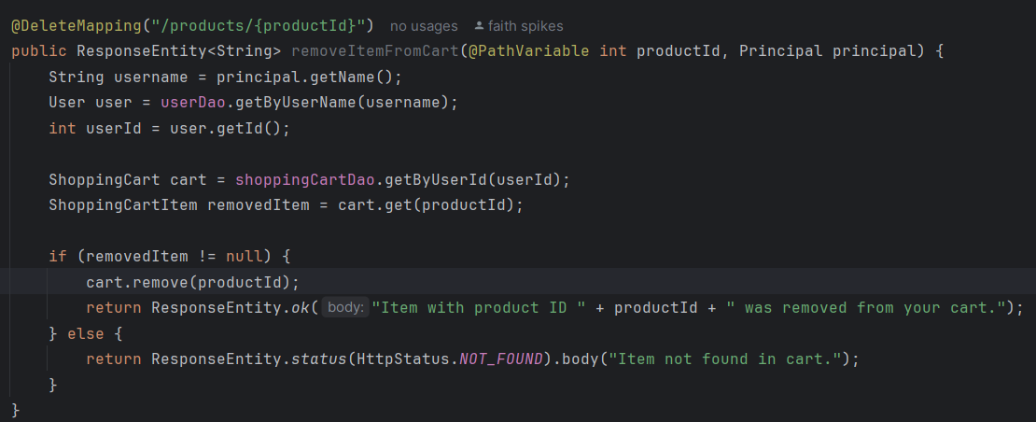
Backroom: For Employees Only

Slide 6

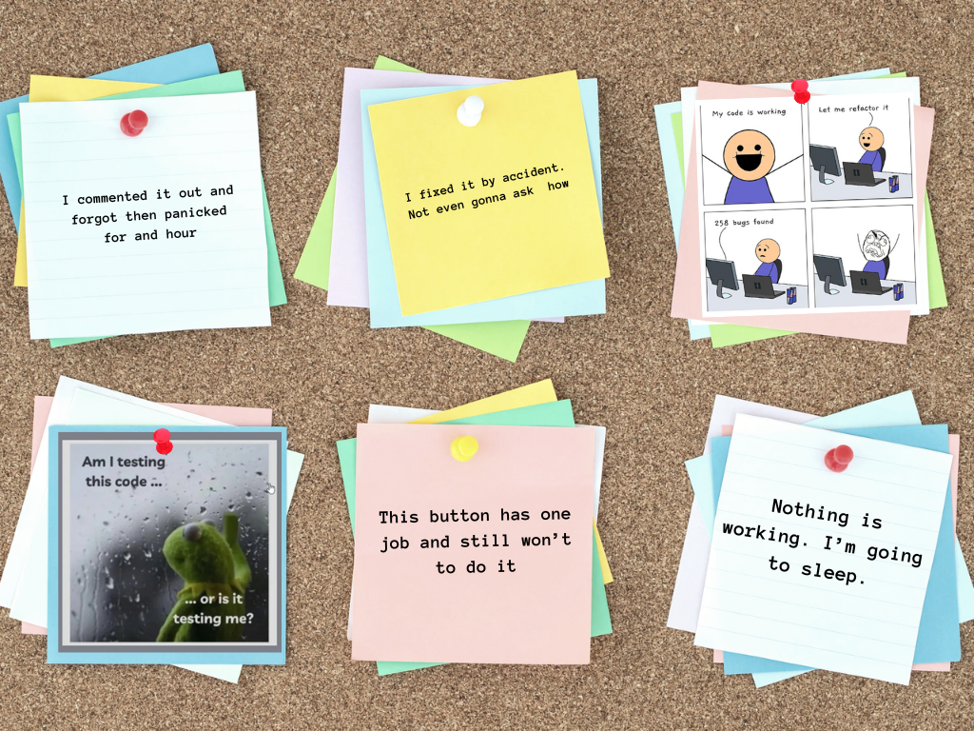
Stockroom Chaos: Bloopers

Slide 7



Breakroom Wall: What I Learned
“Not working” doesn’t mean you’re failing. It means you’re learning.
If nothing’s showing up, it’s probably display none;
If you think it works properly, retest.
You can make something beautiful, even when you feel like a mess.
Every 'quick fix' comes with a side of chaos.
Sit down.
Be humble.

Slide 8
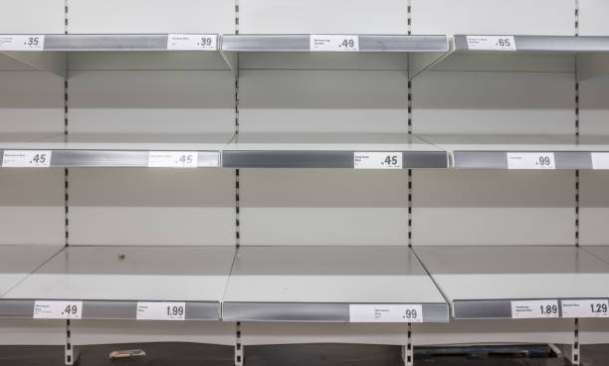


Feature Preview: Phase 2 On Deck
Admin Profile
Mood Kits
User Profile
🔐 Manage Mood Kits
📦 Add Digital Resources
📊 View User Insights
🧠 Curated based on how you feel
📦 Ships with digital support tools
🎧 Includes audio, journaling, and more
Your Personalized Mood Space
✅ Save Mood Quiz results
📥 View kit history
💬 Access Messages Vault

Slide 9

Thanks For Stopping By!
More About Easy Shop:
https://github.com/Fspike1/EasyShop-ecommerce-Api/tree/main/capstone-starter/src/main/java/org/yearup
About The Designer:
www.linkedin.com/in/faith-spikes

